Slide 1
ASSIGNMENT 2
ROBUST REGRESSION TO ESTIMATE INCOME BASED ON GIVEN PREDICTORS
SARAL JOSHI

Slide 2
CONTENTS
PROBLEM DISCUSSION
RUNNING OLS TO CHECK FOR OUTLIERS
ROBUST METHODS
CHECKING ROBUSTNESS
TRYING OUT STUFF
FINAL RESULTS

Slide 3
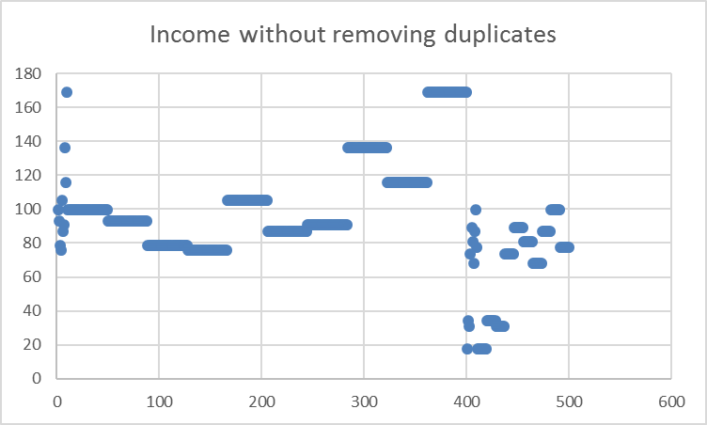
PROBLEM DISCUSSION
Given data has income of 500 individuals, with their experience and education length and race.
We have to estimate the income of an individual using regression analysis. The end goal being comparing the income of one race against the other. Issue: The data has several repeated observations due to averaging out done by source of data. Hence, any algorithm we try on the data will look at the data like this:
Therefore, the regression analysis results will be pulled towards observations that are more in number. WE could say there is not enough variance in the data to build a good model.

Slide 4
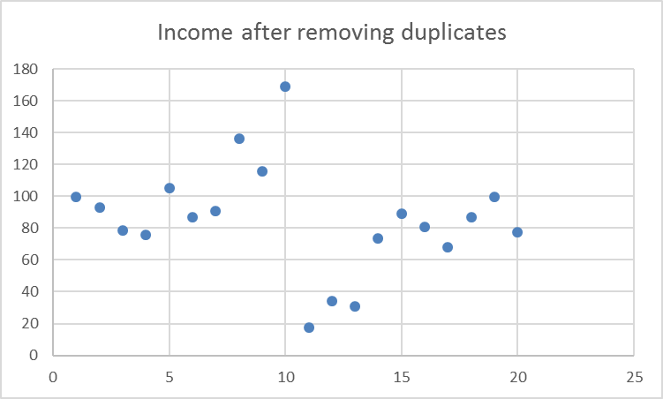
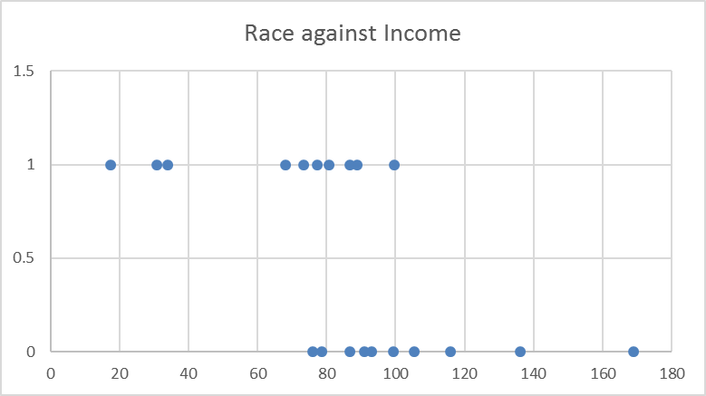
PROBLEM DISCUSSION
However, when we remove duplicates from the data we find 20 unique observations with income distribution as below. The chart on the left is just 20 data points and summarizes the unique points in the data, there is a clear separation in the data due to some underlying factor. We checked for race against income and found the chart on the right, there is a clear separation of income levels on basis of race. Using this info, we could do a discriminant analysis with Race as dependent, and find the separation point for income. However, we will attempt robust regression methods to predict difference in income.
Income against race for unique points
Unique Points only

Slide 5
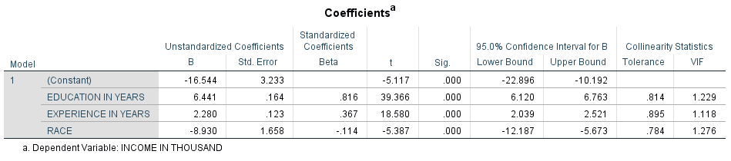
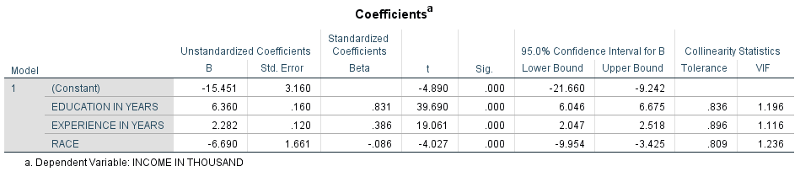
OLS Regression
Simple OLS regression taking all predictors in the model resulted in the below coefficients. As can be seen race has a strong negative impact on income. When the race is 1, the income will be reduced by a factor of 8.93. We use residues generated by OLS to calculate Cook’s D and obtain outliers. The outliers were then separated and the OLS was run again. (Criteria used was 4/n = 0.008, in this case). The size of coefficient for race goes down, however, education and experience are robust, with same size and small std. errors.
Normal OLS
Excluding Outliers

Slide 6
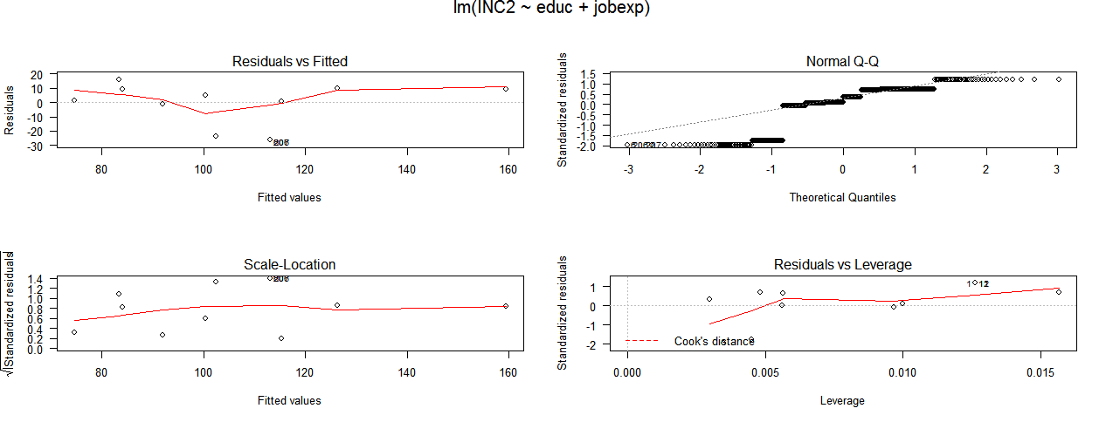
OLS Regression
Regression diagnostics had earlier revealed that there may some outliers. Cook’s D lines are not visibly clear due to scaling issues, and Normal Q-Q plot clearly shows that errors are non-normal. This plot more than anything tells us that robust techniques need to applied to ensure that the results are good.

Slide 7
Robust Methods
We used Huber and Tukey’s Bi-square outlier weighing methods to do some robust regression. To check for robustness we tried random samples, removing or adding variables and changing the k-value, we also had to set iterations to 45. There were several regression outputs and some of them are presented here for comparison.
As seen above, Huber leads to more significant results, because it has larger abs t-values, and smaller std. error. There is not a very large departure from OLS as well.
However, we need to check for robustness of these models as well. Specially since we saw near perfect separation in the data earlier. We check the coefficients using random samples and changing the number of predictors.

Slide 8
Checking for Robustness
We created 6 random samples of n=300 each (using dplyr) and ran Huber based regression to obtain disappointing results for the race coefficient. Since the coefficient ranged from -8 to <-11 with standard error differing from 1.2 to 2.1 However, the results were robust for education and experience. Below table shows the coefficients for race in various samples. We also tried to remove variables from the analysis to check how coefficients change and found drastic changes, specially in the race variable, those results are not shown here.
Fig. Coefficients and std. errors for race across random samples

Slide 9
Trying out stuff
1) We then attempted to do the exact same analyses with only unique data rows and got the same results.
2) Splitting data into black and white to get coefficients of income for the two data sets, this worked well, and showed black have lower salary. It also had robust results, but it is not shown here because the third method worked better. Besides, splitting the data is not a good long term plan, since the models cannot be used in the future.
2) Tried to change from “M” estimation to “MM” estimation. This resulted in robust results however, the scale of race went down significantly, see next slide for results.

Slide 10
Checking for Robustness
Again we created 6 random samples of n=300 each and ran bi-square weight method with MM estimation based regression to obtain good results for all variable coefficients. Since the coefficient ranged from –0.9 to -1 with standard error differing between 0.15 to 0.17. Below table shows the coefficients for race in various samples. Table to the right shows the coefficients from one of the samples.
Coefficients from 1 sample, very similar values seen in other random samples.
Taking above results into consideration, we can conclude the results are robust for the random samples, hence we can run the MM estimation bi square regression on the population data.

Slide 11
Final Results
We used the MM estimation on whole population with both Huber and bi-square and got the exact same results for all estimated parameters, The results are shown below.
Residual standard error: 1.234 on 496 degrees of freedom
Final results with whole population
Final results indicate that education and job experience have a much larger effect on income compared to race. Race is the least significant variable with a magnitude of only -0.925. These results clearly indicate the need for RR. Out intuition says that one race does have lower salary than the other and initial statistics agree strongly with that hypothesis. But with proper RR we can clearly say that race has very little effect on income.

